Slide 1



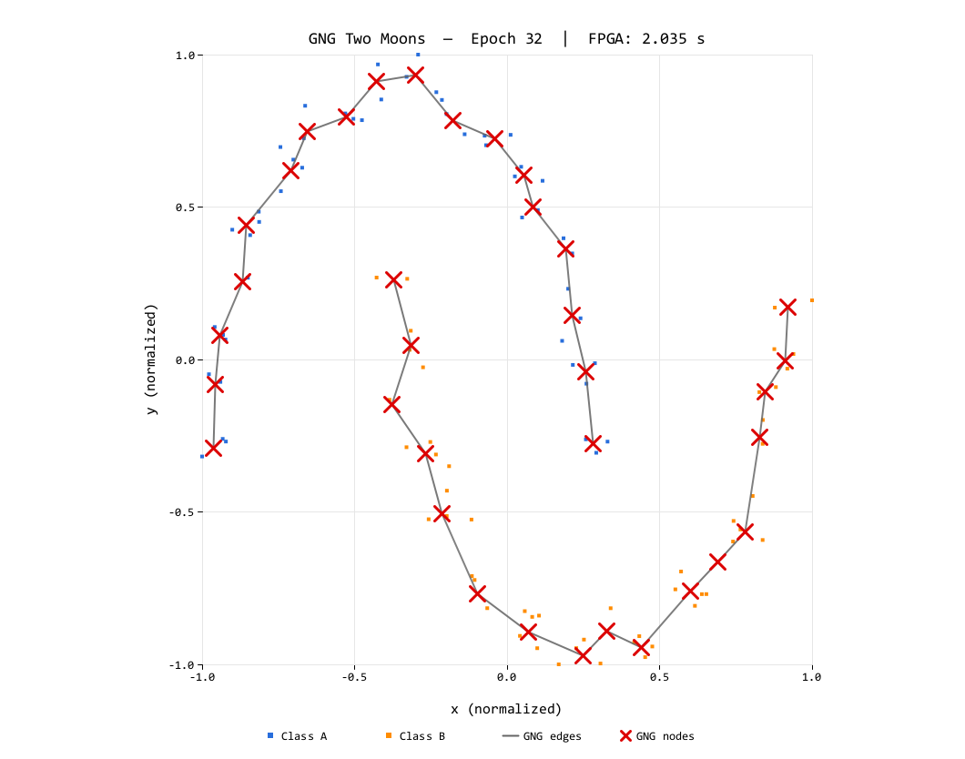
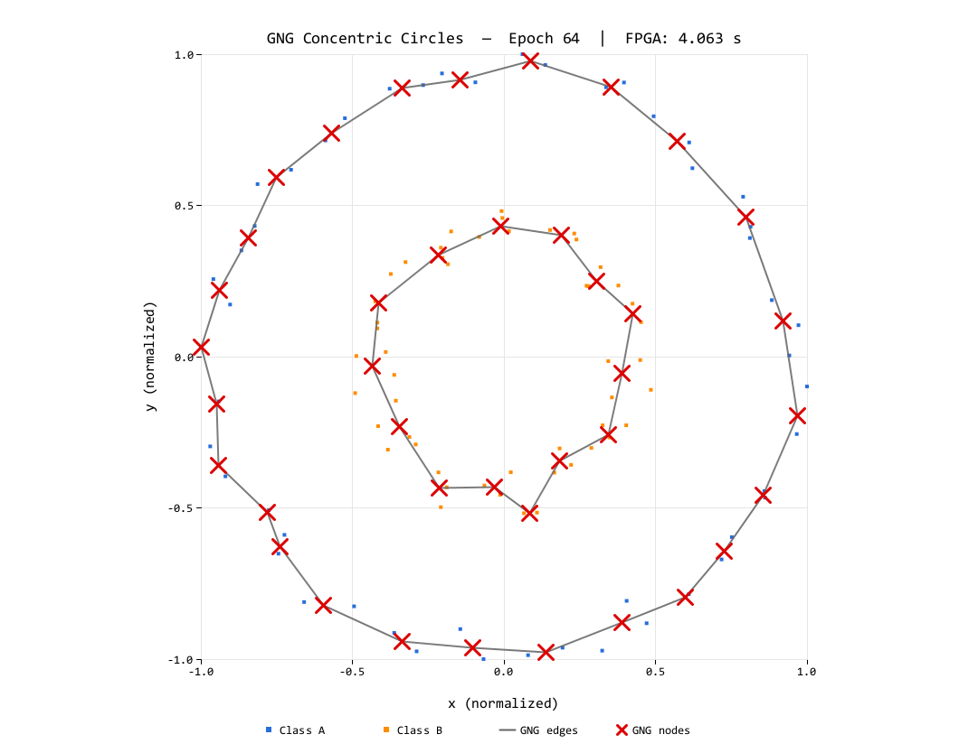
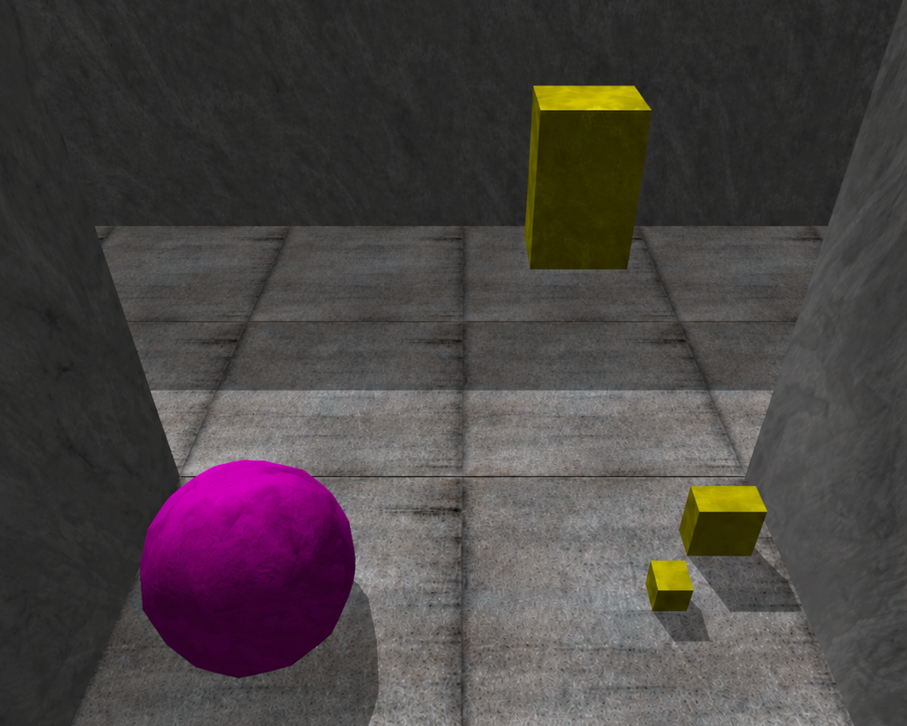
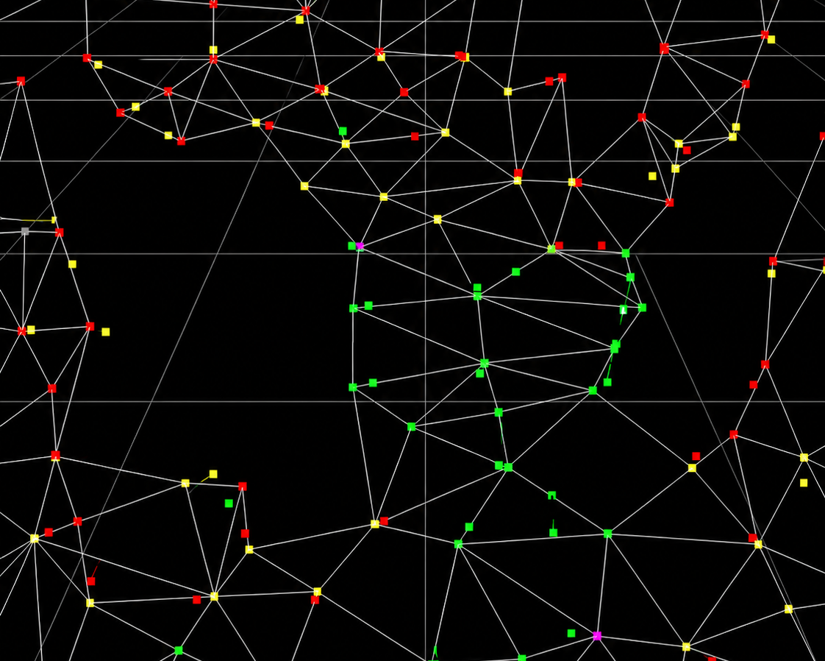
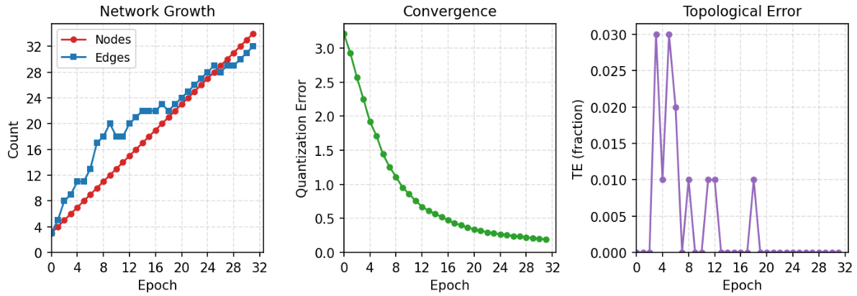
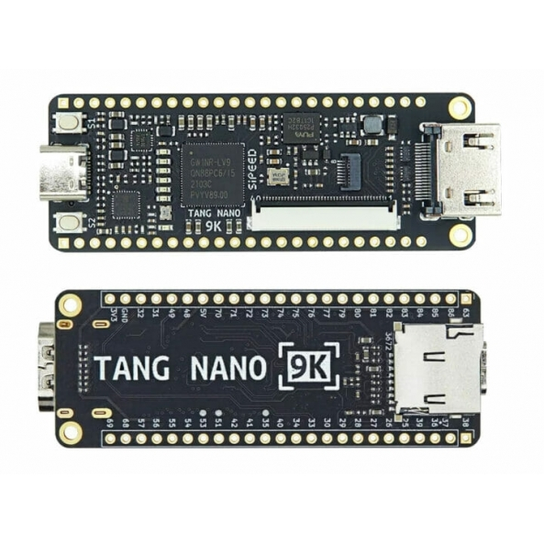
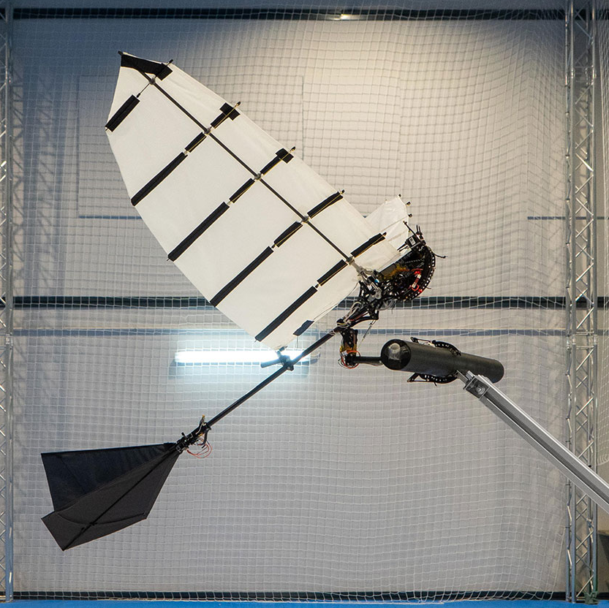
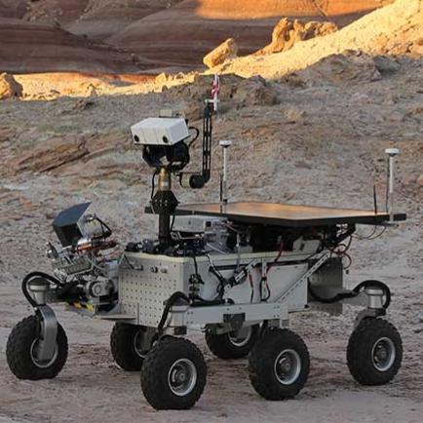
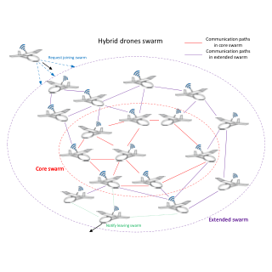
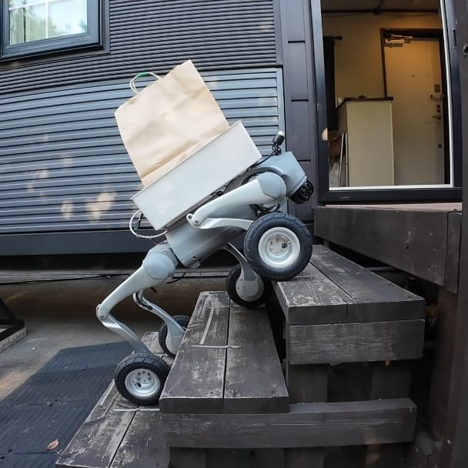
IEEE WCCI 2026 · MAASTRICHT, NETHERLANDS · 21–26 JUNE 2026 · POSTER SESSION
Edge-Cell Graph Encoding and Fixed-Point Arithmetic for FPGA Growing Neural Gas
Bringing unsupervised learning down to the embedded level
Teuku Zikri Fatahillah¹ · Raditya Artha Rochmanto^{1,2} · Achmad Fahrul Aji^{1,2}
Anhar Risnumawan^{1,3} · Chyan Zheng Siow^{1,4} · Naoyuki Kubota¹
CODE & DATA
¹ Tokyo Metropolitan University, Japan · ² Politeknik Negeri Semarang, Indonesia
github.com/tzf230201/fpga_gng
−41%
³ Politeknik Elektronika Negeri Surabaya, Indonesia · ⁴ Changsha Cultural and Creative Arts Vocational College, China
~625 µs
38%
smaller graph-state memory (2,000 B → 1,180 B)
deterministic latency / sample (≈1,600 / s)
LUT used on a 9K FPGA — 62% headroom left
1 · Motivation & Problem
CORE METHOD
6 · Results — It Fits, and It Learns
Micro-UAV swarms and field robots need on-board unsupervised adaptation — streaming raw data to the cloud is impractical. Learning must run locally, with bounded memory and deterministic timing .
4 · Edge-Cell Encoding
38%
22%
24%
50%
Edges are undirected, so store only the upper triangle of the adjacency — one byte per node pair, coding presence and age together :
LUT · 3,205/8,640
FF · 1,408/6,693
BSRAM · 6/26
DSP · 5/10
Growing Neural Gas (GNG) learns topology incrementally, sample-by-sample, without labels — ideal for streaming data. But classic GNG clashes with small FPGAs:
Place-and-route on Gowin GW1NR-LV9QN88PC6 (Gowin EDA V1.9.12.01) — 62% LUT and 76% BRAM headroom remain for application logic.
← node i
node j →
Many deep learning systems rely on labels, pretraining, or task-specific prior knowledge. In unseen or changing environments, robots may need to discover structure directly from streaming sensory data. Unsupervised topology learning methods such as SOM and GNG can learn online without labels.
0
0
1
2
3
4
5
1
3
1
0
0
0
cell = age + 1 (stored edge)
2
0
7
0
0
cell = 0 (no edge)
FPGA
3
2
5
0
lower triangle + diagonal — never stored
4
0
1
Topologies learned on the FPGA , streamed via UART snapshots. Left: Two Moons (epoch 32). Right: Concentric Circles (epoch 64). 100 samples each, N_{max} = 40.
5
4
Topological mapping in action: a robot explores its surroundings (left) while GNG incrementally builds a graph mirroring the free-space topology (right) — applications like this need adaptation to run on the device itself: payload-, power-, and link-constrained.
Half-adjacency indexing — flatten the 2D upper triangle into one 1D array, row by row:
▸
Dense adjacency is O(N²): a 40×40 8-bit matrix = 1,600 B — it dominates the BRAM budget of a sub-10K-LUT device.
0
1
2
3
4
5
6
7
8
9
10
11
12
13
14
0,1
0,2
0,3
0,4
0,5
1,2
1,3
1,4
1,5
2,3
2,4
2,5
3,4
3,5
4,5
idx(i, j) =
i (2N_{max} − i − 1)
+ (j − i − 1)
(1,3) → cell 6
▸
Floating-point needs FPU blocks or slow iterative units — integer-only datapaths map cleanly to LUTs and DSPs.
2
Implementation
Node
Edge
Total
Two Moons (final)
Concentric Circles (final)
▸
Prior FPGA self-organizing work targets SOMs with static lattices — GNG's per-iteration edge insert/age/prune on a variable graph is the hard part.
Dense adjacency (baseline)
400 B
1,600 B
2,000 B
QE 0.146 · TE 0.01
QE 0.196 · TE 0.07
Edge-cells (proposed)
400 B
780 B
1,180 B
QE (quantization error) drops steadily on both datasets and TE (topological error) stays near zero — the integer engine matches floating-point GNG quality. TE drifts slightly on Circles only after N _{max} saturates.
2 · Method Overview
−51.25% edge storage · −41% total graph state at N_{max} = 40 — freeing BRAM for application logic.
A fully integer, single-FSM GNG engine in synthesizable VHDL on the Sipeed Tang Nano 9K (Gowin GW1NR-9C) — no soft-core CPU, no FPU, no PLL.
5 · Fixed-Point Arithmetic
7 · Deterministic Real-Time Throughput
Integer-only datapath —
No floating-point unit. The whole engine runs on a Tang Nano 9K @ 27 MHz
(single FSM, 3 BRAMs, UART 1 Mbit/s).
~625 µs
~16.9k
~1,600
i
Edge-cell encoding — upper-triangular half-adjacency with 8-bit age+1 cells: 780 B vs 1,600 B edge storage.
per sample
cycles @ 27 MHz
samples / s
Shift-based Q8/Q16 learning rates — every adaptation step is one multiply + shift, single DSP cycle.
Measured from an on-chip 32-bit cycle counter embedded in every debug frame — Two Moons: 16,852 cycles (624.1 µs); Circles: 16,931 cycles (627.1 µs). Latency is dominated by the two O(N _{max}) BRAM scans — bounded and near-identical across datasets .
ii
Tang Nano 9K · GW1NR-9C
iii
Fused NB_SCAN pass — error decay + edge aging + neighbor movement + pruning in one sequential sweep; no separate full-array decay pass.
Coordinate representation — 16-bit signed integers in [−1000, 1000] after min-max normalization:
8 · Takeaway & Future Work
iv
Per-node degree counters — O(N_{max} ) isolated-node detection without scanning the edge array.
x_{norm} =
(
x − x_{min}
)
· 2s − s ,
s = 1000
Self-organizing clustering with dynamic topology is feasible on a sub-10K-LUT FPGA — when memory layout and arithmetic format are treated as first-class design concerns. Bounded state + incremental updates make this a hardware substrate for continual learning at the edge .
x_{max} − x_{min}
3 · GNG Loop
80-bit node word — one BRAM entry per node:
x [16]
y [16]
deg [8]
err [32]
①
Find winner s₁ = argminᵢ ‖ξ − wᵢ‖² and runner-up s₂.
Squared-distance unit — maps directly onto a 9×9 DSP multiplier, overflow-free:
②
Accumulate winner error; move s₁ toward ξ by ε_{w}.
Δx = ξ_{x} − x_{n} , Δy = ξ_{y} − y_{n} 17-bit signed
Streaming sensor input — adapt continuously without restart
Pipelined O(log N) winner-search tree
③
Age edges of s₁; move its neighbors by ε_{n}; prune edges past A_{max}.
d² = Δx² + Δy² 35-bit unsigned
④
Connect (s₁, s₂) with age 0; decay all errors by β.
Parametric learning rates — one multiply + shift each (single DSP cycle):
Q-format precision via VHDL generics
Multi-stream on-board unsupervised mapping
⑤
Every λ samples: insert a node between the max-error node and its worst neighbor; split errors by α.
Winner (Q8)
Δx
s₁
= ⌊
77 (ξ_{x} − x_{s₁})
⌋
ε_{w} ≈ 0.301
2⁸
PROSPECTIVE APPLICATIONS
Neighbor (Q16)
Δx
n
= ⌊
66 (ξ_{x} − x_{n})
⌋
ε_{n} ≈ 0.001
Sample input ξ
SAMPLE
2¹⁶
↓
Multiplierless error decay
err −= err ≫ 8
no multiplier (β ≈ 0.9961)
Find winner s₁, runner-up s₂
WIN_SCAN
Fused update: winner move, edge aging, neighbor move, error decay & pruning all run in one NB_SCAN sweep — independent per-edge ops, parallelizable on FPGA.
↓
FUSED IN ONE SWEEP · UPDATE + NB_SCAN
Σ accumulate s₁ error
Move s₁ toward ξ (ε_{w})
Parameter
Value
Hardware mapping
Age s₁ edges + prune
Move neighbors (ε_{n})
Nₘₐₓ (max nodes)
40
node BRAM depth
Aerial robot
Exploration robot
independent per-edge ops → parallelizable on FPGA
Aₘₐₓ (max edge age)
50
A_MAX_STORED = 51
↓
λ (insertion period)
100
lambda_cnt counter
Connect (s₁, s₂) · decay errors (β)
CONNECT
εw (winner lr)
≈ 0.301
EPS_WIN_Q8 = 77, ≫ 8
↓
εn (neighbor lr)
≈ 0.001
EPS_N_Q16 = 66, ≫ 16
Insert node @ λ · remove old/isolated
INSERT
α (error split)
0.5
INS_ALPHA_SHIFT = 1
↻ repeat until termination
β (error decay)
≈ 0.9961
ERR_DECAY_SHIFT = 8
Each BRAM read-modify-write takes ≥ 3 cycles → deterministic, bounded per-sample latency .
ERR_SHIFT (acc. scale)
4
d² ≫ 4 before accum.
Drone swarm
Bio-inspired robot
Selected References
[2] T. Kohonen, “Self-organized formation of topologically correct feature maps,” Biol. Cybern. , 1982.
[8] J. Holmström, “Growing neural gas with utility,” Neural Networks, 2002.
[1] B. Fritzke, “A growing neural gas network learns topologies,” NeurIPS, 1994.
[16] P. Coelho et al., “FPGA implementation of self-organizing maps using fixed-point arithmetic,” J. Signal Process. Syst. , 2020.
[25] Piyasena et al., dynamically growing SO network (GWR-like) on FPGA for lifelong learning at the edge.
[26] Firmli et al., compressed sparse row (CSR++) for low-degree-graph memory reduction.
Supported by the Japan Science and Technology Agency (JST), Moonshot R&D Program, grant JPMJMS2034.
[email protected]

